Slide 1

Data Integration and Large Scale Analysis 08 Cloud Resource Management
Last update: Nov 25, 2022

Slide 2
Course Outline Part B: Large-Scale Data Management and Analysis
12 Distributed Stream Processing
13 Distributed Machine Learning Systems
11 Distributed Data-Parallel Computation
Compute/ Storage
10 Distributed Data Storage
09 Cloud Resource Management and Scheduling
Infra
08 Cloud Computing Fundamentals

Slide 3
Agenda
Motivation, Terminology, and Fundamentals
Resource Allocation, Isolation, and Monitoring
Task Scheduling and Elasticity

Slide 4
Motivation, Terminology, and Fundamentals

Slide 5
Recap: Motivation Cloud Computing, cont.
Motivation, Terminology, and Fundamentals
100%
Argument #1: Pay as you go
No upfront cost for infrastructure
Variable utilization ➔ over-provisioning
Pay per use or acquired resources
Argument #2: Economies of Scale
Purchasing and managing IT infrastructure at scale ➔ lower cost (applies to both HW resources and IT infrastructure/system experts)
Focus on scale-out on commodity HW over scale-up ➔ lower cost
Argument #3: Elasticity
Assuming perfect scalability, work done in constant time * resources
Given virtually unlimited resources allows to reduce time as necessary
Utili-zation
Time
100 days @ 1 node
≈
1 day @ 100 nodes (but beware Amdahl’s law: max speedup sp = 1/s)

Slide 6
Overview Resource Management & Scheduling
Motivation, Terminology, and Fundamentals
Resource Bundles
Logical containers (aka nodes/instances) of different resources (vcores, mem)
Disk capacity, disk and network bandwidth
Accelerator devices (GPUs, FPGAs), etc
Resource Management
Scheduling is a fundamental computer science technique (at many different levels)
Resource Selection
Resource Allocation
Resource Isolation & Monitoring
Task Scheduling
4x m5.large (2vCPU, 8GB Mem)
12/48GB
10/12 vc
8
2

Slide 7
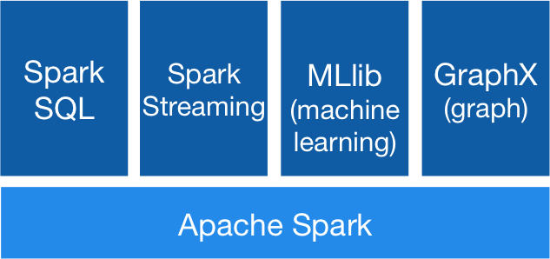




Recap: Apache Spark History and Architecture
Motivation, Terminology, and Fundamentals
High-Level Architecture
Different language bindings: Scala, Java, Python, R
Different libraries: SQL, ML, Stream, Graph
Spark core (incl RDDs)
Different file systems/ formats, and data sources: HDFS, S3, DBs, NoSQL
Different cluster managers: Standalone, Mesos, Yarn, Kubernetes
➔ Separation of concerns: resource allocation vs task scheduling
[https://spark.apache.org/]
Standalone
MESOS
YARN
Kubernetes

Slide 8
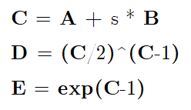
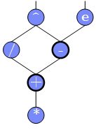
Scheduling Problems
Motivation, Terminology, and Fundamentals
[Eleni D. Karatza: Cloud Performance Resource Allocation and Scheduling Issue, Aristotle University of Thessaloniki 2018]
Bag-of-Tasks Scheduling
Job of independent (embarrassingly parallel) tasks
Examples: EC2 instances, map tasks
Gang Scheduling
Job of frequently communicating parallel tasks
Examples: MPI programs, parameter servers
DAG Scheduling
Job of tasks with precedence constraints (e.g., data dependencies)
Examples: Op scheduling Spark, TensorFlow, SystemDS
Real-Time Scheduling
Job or task with associated deadline (soft/hard)
Examples: rendering, car control
A
s
B
Notes:
Note: real-time scheduling w/ regular or irregular deadlines

Slide 9
Basic Scheduling Metrics and Algorithms
Motivation, Terminology, and Fundamentals
Common Metrics
Mean time to completion (total runtime for job), and max-stretch (completion/work – relative slowdown)
Mean response time (job waiting time for resources)
Throughput (jobs per time unit)
#1 FIFO (first-in, first-out)
Simple queueing and processing in order
Problem: Single long-running job can stall many short jobs
#2 SJF (shortest job first)
Sort jobs by expected runtime and execute in order ascending
Problem: Starvation of long-running jobs
#3 Round-Robin (FAIR)
Allocate similar time (tasks, time slices) to all jobs

Slide 10
Resource Allocation, Isolation, and Monitoring

Slide 11
Resource Selection
Resource Allocation, Isolation, and Monitoring
#1 Manual Selection
Rule of thumb (I/O, mem, CPU characteristics of app)
Data characteristics, and framework configurations, experience
Example Spark Submit
export HADOOP_CONF_DIR=/etc/hadoop/conf
SPARK_HOME=../spark-2.4.0-bin-hadoop2.7
$SPARK_HOME/bin/spark-submit \
--master yarn --deploy-mode client \
--driver-java-options "-server –Xms40g –Xmn4g" \
--driver-memory 40g \
--num-executors 10 \
--executor-memory 100g \
--executor-cores 32 \
SystemDS.jar -f test.dml -stats -explain -args …

Slide 12
Resource Selection, cont.
Resource Allocation, Isolation, and Monitoring
#2 Application-Agnostic, Reactive
Dynamic allocation based on workload characteristics
Examples: Spark dynamic allocation, Databricks AutoScaling
#3 Application-Aware, Proactive
Estimate time/costs of job under different configurations (what-if)
Min $costs under time constraint
Min runtime under $cost constraint
[Herodotos Herodotou, Fei Dong, Shivnath Babu: No one (cluster) size fits all: automatic cluster sizing for data-intensive analytics. SoCC 2011]
(fixed MR job w/ 6 nodes)

Slide 13

Resource Negotiation and Allocation
Resource Allocation, Isolation, and Monitoring
“Tetris Analogy” (w/ expiration and queues)
Problem Formulation
N nodes with memory and CPU constraints
Stream of jobs with memory and CPU requirements
Assign jobs to nodes (or to minimal number of nodes)
➔ Knapsack problem (bin packing problem)
In Practice: Heuristics
Major concern: scheduling efficiency (online, cluster bottleneck)
Approach: Sample queues, best/next-fit selection
Multiple metrics: dominant resource calculator
12/48GB
8GB
2
32GB
[https://blog.cloudera.com/managing-cpu-resources-in-your-hadoop-yarn-clusters/]
6/8GB
1/32GB
2/8GB
1
6
8GB
Notes:
TODO algorithm for schedule requests -> minimize relative waste
Note: story Spark driver and executor on same node → long scheduling delay → slows down ALL executors

Slide 14

Slurm Workload Manager
Resource Allocation, Isolation, and Monitoring
Slurm Overview
Simple Linux Utility for Resource Management (SLURM)
Heavily used in HPC clusters (e.g., MPI gang scheduling)
Scheduler Design
Allocation/placement of requested resources
Considers nodes, sockets, cores, HW threads, memory, GPUs, file systems, SW licenses
Job submit options: sbatch (async job script), salloc (interactive), srun (sync job submission and scheduling)
Configuration: cluster, node count (ranges), task count, mem, etc
Constraints via filters: sockets-per-node, cores-per-socket, threads-per-core mem, mem-per-cpu, mincpus, tmp min-disk-space
Elasticity via re-queueing
[Don Lipari: The SLURM Scheduler Design, User Group Meeting, 2012]

Slide 15
Background: Hadoop JobTracker (anno 2012)
Resource Allocation, Isolation, and Monitoring
Overview
Hadoop cluster w/ fixed configuration of n map slots, m reduce slots (fixed number and fixed memory config map/reduce tasks)
JobTracker schedules map and reduce tasks to slots
FIFO and FAIR schedulers, account for data locality
Data Locality
Levels: data local, rack local, different rack
Delay scheduling (with FAIR scheduler) wait 1-3s for data local slot
Problem
Intermixes resource allocation and task scheduling → Scalability problems in large clusters
Forces every application into MapReduce programming model
[Matei Zaharia et al: Delay scheduling: a simple technique for achieving locality and fairness in cluster scheduling. EuroSys 2010]

Slide 16

Mesos Resource Management
Resource Allocation, Isolation, and Monitoring
[Benjamin Hindman et al: Mesos: A Platform for Fine-Grained Resource Sharing in the Data Center. NSDI 2011]
Overview Mesos
Fine-grained, multi-framework cluster sharing
Scalable and efficient scheduling → delegated to frameworks
Resource offers

Slide 17
Mesos Resource Management, cont.
Resource Allocation, Isolation, and Monitoring
Resource Offers
Mesos master decides how many resources to offer
Framework scheduler decides which offered resources to accept/reject
Challenge: long waiting times, lots of offers → filter specification
Offered resources
Reported available resources
Mesosphere Marathon: container orchestration (e.g., Docker)

Slide 18
YARN Resource Management
Resource Allocation, Isolation, and Monitoring
[Vinod Kumar Vavilapalli et al: Apache Hadoop YARN: yet another resource negotiator. SoCC 2013]
Overview YARN
Hadoop 2 decoupled resource scheduler (negotiator)
Independent of programming model, multi-framework cluster sharing
Resource Requests
Resource Scheduling via Resource Manager
Task Scheduling via Application Masters (AMs)
Resource Isolation via Node Managers

Slide 19
YARN Resource Management, cont.
Resource Allocation, Isolation, and Monitoring
Capacity Scheduler
Hierarchy of queues w/ shared resource among sub queues
Soft (and optional hard) [min, max] constraints of max resources
Default queue-user mapping
No preemption during runtime (only redistribution over queues)
Fair Scheduler
All applications get same resources over time
Fairness decisions on memory requirements, but dominant resource fairness possible too
data science
root
indexing

Slide 20

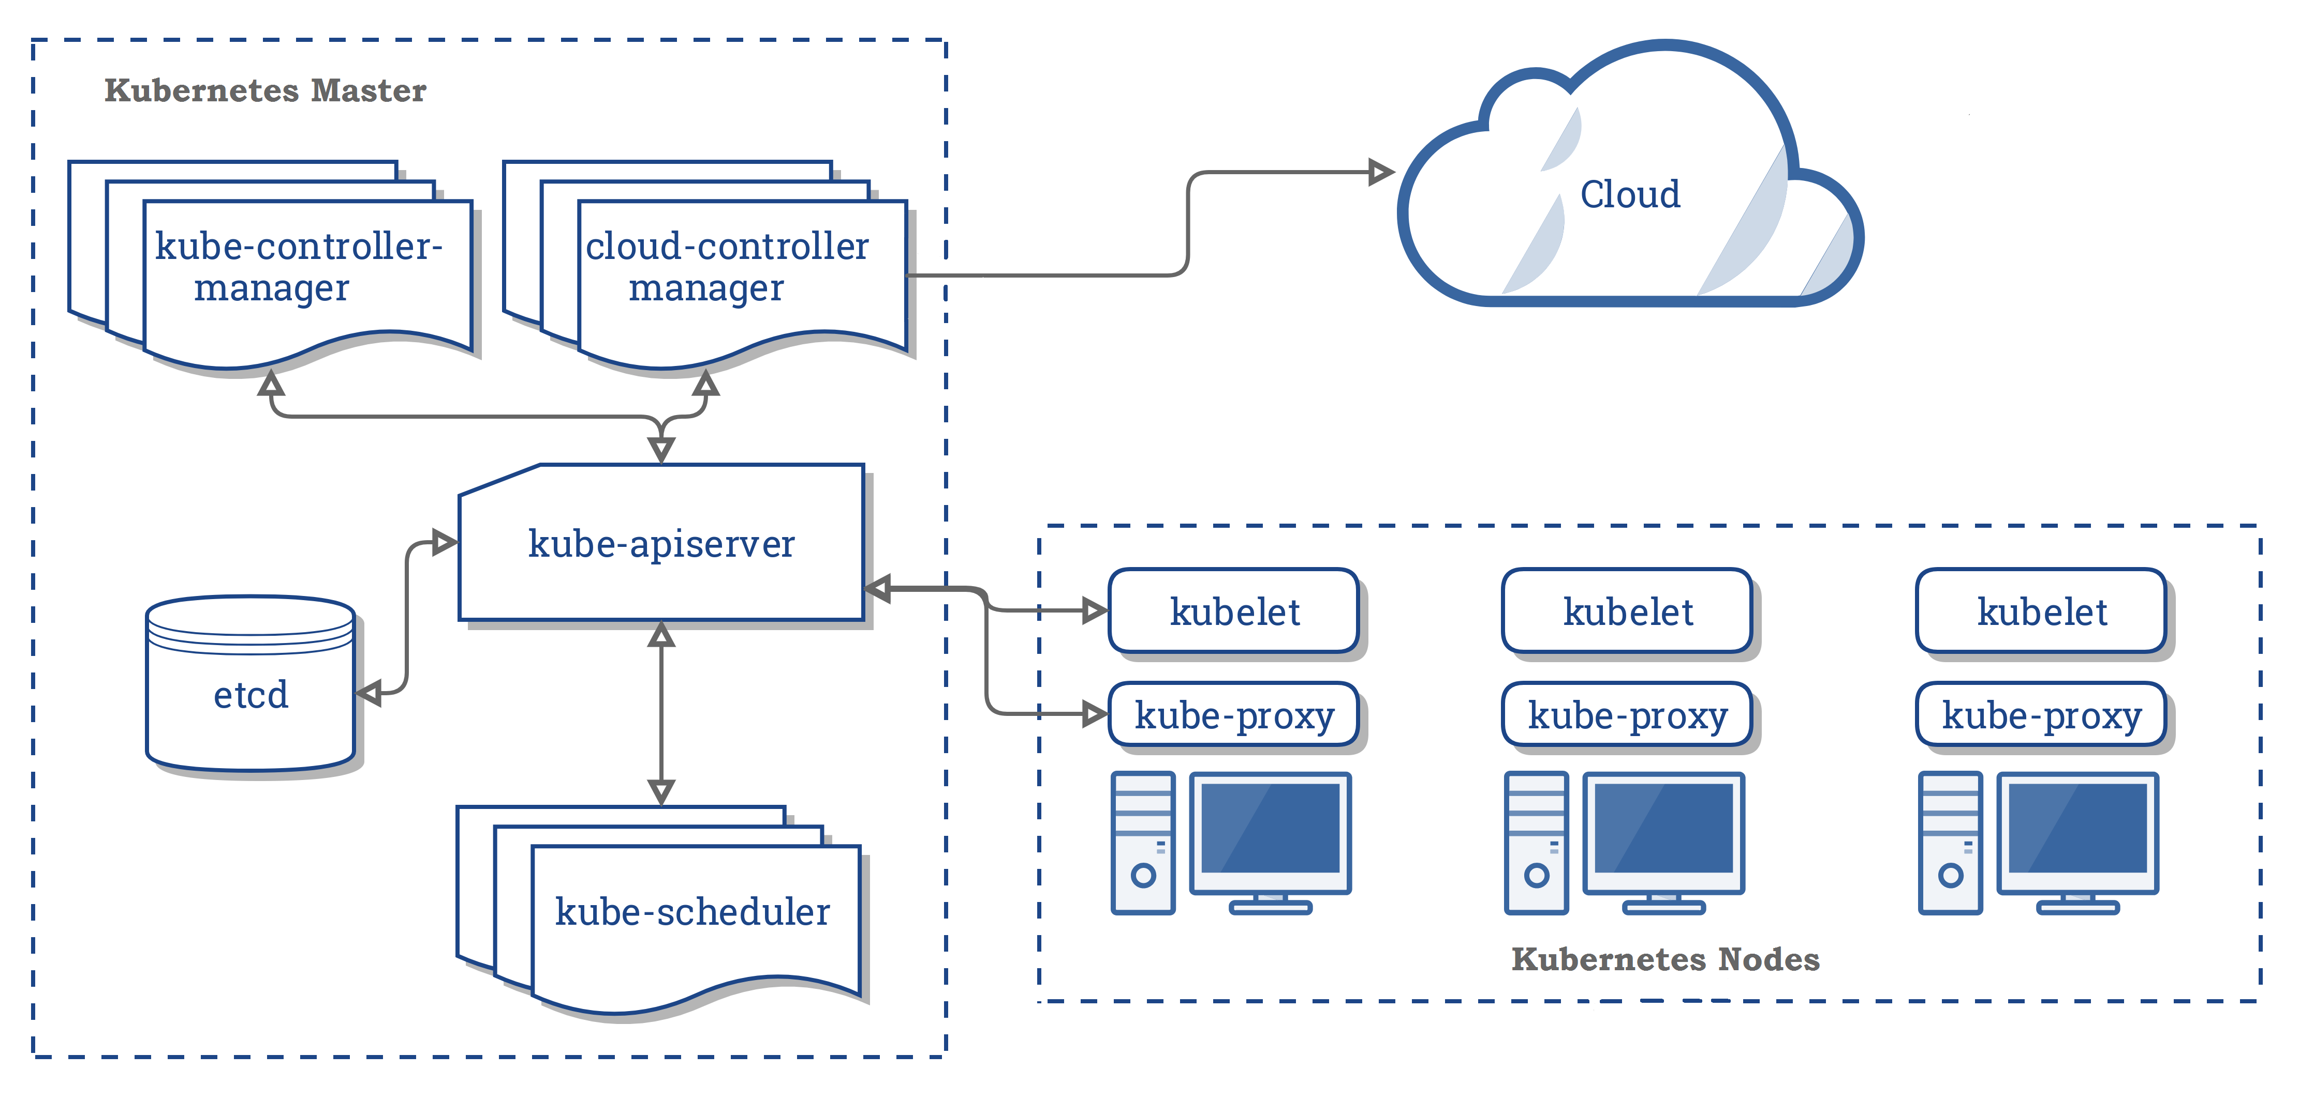
Kubernetes Container Orchestration
Task Scheduling and Elasticity
Overview Kubernetes
Open-source system for automating, deployment, and management of containerized applications
Container: resource isolation and application image
System Architecture
Pod: 1 or more containers w/ individual IP
Kubelet: node manager
Controller: app master
API Server + Scheduler
Namespaces, quotas, access control, auth., logging & monitoring
Wide variety of applications
➔ from machine- to application-oriented scheduling
KV Store
[https://kubernetes.io/docs/concepts/ overview/components/]
Notes:
Note: Kubernetes name – seven of nine (friendlier borg) → seven spokes

Slide 21
Kubernetes Container Orchestration, cont.
Task Scheduling and Elasticity
Pod Scheduling (Placement)
Default scheduler: kube-scheduler, custom schedulers possible
#1 Filtering: finding feasible nodes for pod (resources, free ports, node selector, requested volumes, mem/disk pressure)
#2 Scoring: score feasible nodes → select highest score (spread priority, inter-pod affinity, requested priority, image locality)
Tuning: # scored nodes: max(50, percentageOfNodesToScore [1,100]) (sample taken round robin across zones)
➔ Binding: scheduler notifies API server

Slide 22
Resource Isolation
Resource Allocation, Isolation, and Monitoring
Overview Key Primitives
Platform-dependent resource isolation primitives → container runtime
Linux namespaces: restricting visibility
Linux cgroups: restricting usage
Cgroups (Control Groups)
Developed by Google engineers → Kernel 2.6.24 (2008)
Resource metering and limiting (memory, CPU, block I/O, network)
Each subsystem has a hierarchy (tree) with each node = group of processes
Soft and hard limits on groups
Mem hard limit → triggers OOM killer (physical, kernel, total)
CPU → set weights (time slices)/no limits, cpuset to pin groups to CPUs
Linux Containers (e.g., basis of Docker)
[Jérôme Petazzoni: Cgroups, name-spaces and beyond: What are containers made from? DockerConEU 2015.]
[https://www.youtube.com/watch?v=sK5i-N34im8&feature=youtu.be]
Notes:
NOTE: Linux Containers, Solaris Projects [Mesos paper]

Slide 23
Task Scheduling and Elasticity

Slide 24
Task Scheduling Overview
Task Scheduling and Elasticity
Problem Formulation
Given computation job and set of resources (servers, threads)
Distribute job in pieces across resources
#1 Job-Task Partitioning
Split job into sequence of N tasks
#2 Task Placement / Execution
Assign tasks to K resources for execution
Goal: Min Job Completion Time
Beware: Max runtime per resource determines job completion time
Computation Job
t₁
t₂
t₃
t₄
t₅
t₆
Node 1
Node 2
Node 1:
t₁
t₂
t₃
t₅
Node 2:
t₄
t₆
Job done

Slide 25
Task Scheduling – Partitioning
Task Scheduling and Elasticity
Example Hyper-param Tuning
parfor(i in 1:800)
R[i,] = lm(X,y,reg[i])
Static Partitioning
M = K tasks, task size ceil(N/K)
Low overhead, poor load balance
Fixed Partitioning
M = N/d tasks, task size d
E.g., # iterations, # tuples to process
Self-Scheduling
Exponentially decreasing task sizes d → M = log N tasks (w/ min task size)
Low overhead and good load balance at end
Guided self scheduling
Factoring: waves of task w/ equal size
400
400
100
100
100
100
100
100
100
100
200
100
50
50
200
100
50
50
[Susan Flynn Hummel, Edith Schonberg, Lawrence E. Flynn: Factoring: a practical and robust method for scheduling parallel loops. SC 1991]

Slide 26
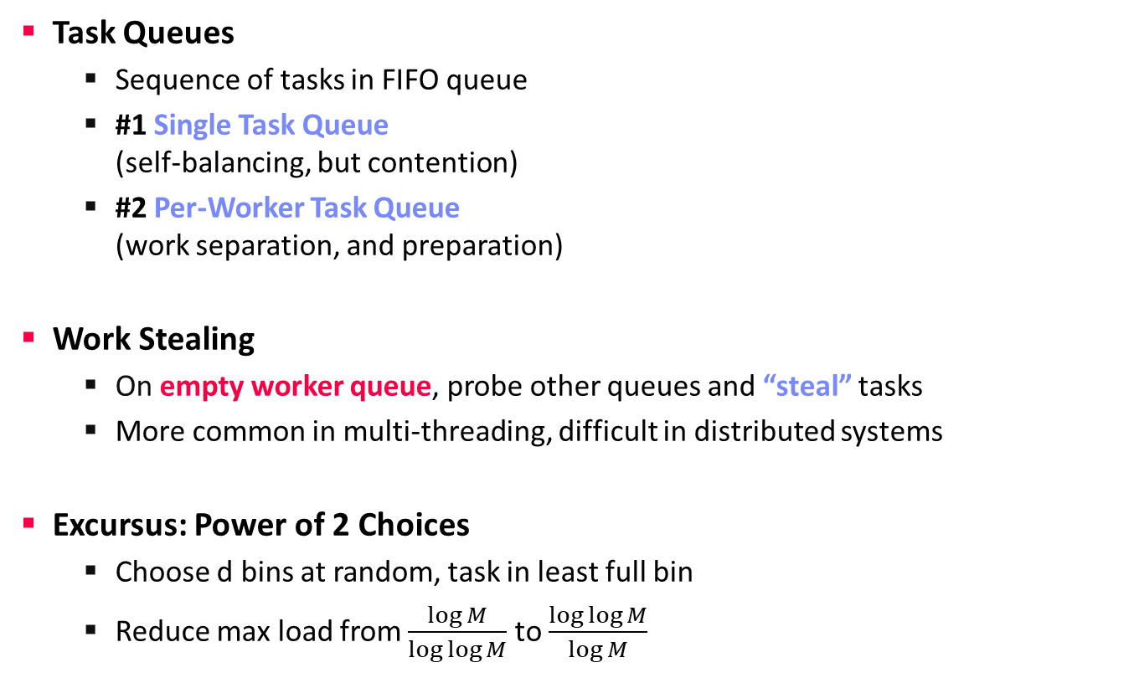
Task Scheduling – Placement
Task Scheduling and Elasticity
Task Queues
Sequence of tasks in FIFO queue
#1 Single Task Queue (self-balancing, but contention)
#2 Per-Worker Task Queue (work separation, and preparation)
Work Stealing
On empty worker queue, probe other queues and “steal” tasks
More common in multi-threading, difficult in distributed systems
Excursus: Power of 2 Choices
Choose d bins at random, task in least full bin
Reduce max load from $\frac{\log{M}}{\log{\log{M}}}$ to $\frac{\log{\log{M}}}{\log{M}}$
Node 1
Node 2
Node 1
Node 2
“Airport”
“Super Market”
[Michael D. Mitzenmacher: The Power of Two Choices in Randomized Load Balancing, PhD Thesis UC Berkeley 1996]

Slide 27
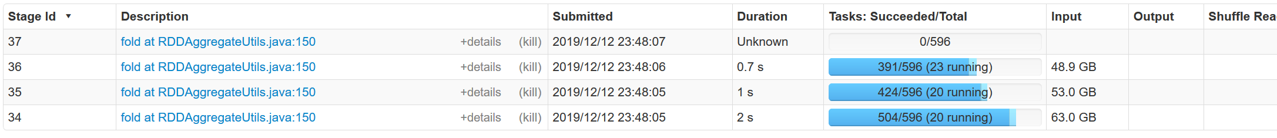
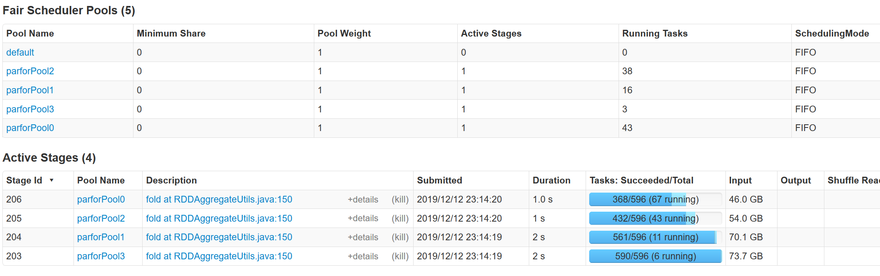
Spark Task Scheduling
Task Scheduling and Elasticity
SystemDS Example (80GB):
X = rand(rows=1e7,cols=1e3)
parfor(i in 1:4)
for(j in 1:10000)
print(sum(X)) #spark job
Overview
Schedule job DAGs in stages (shuffle barriers)
Default task scheduler: FIFO; alternative: FAIR
FIFO
FAIR

Slide 28
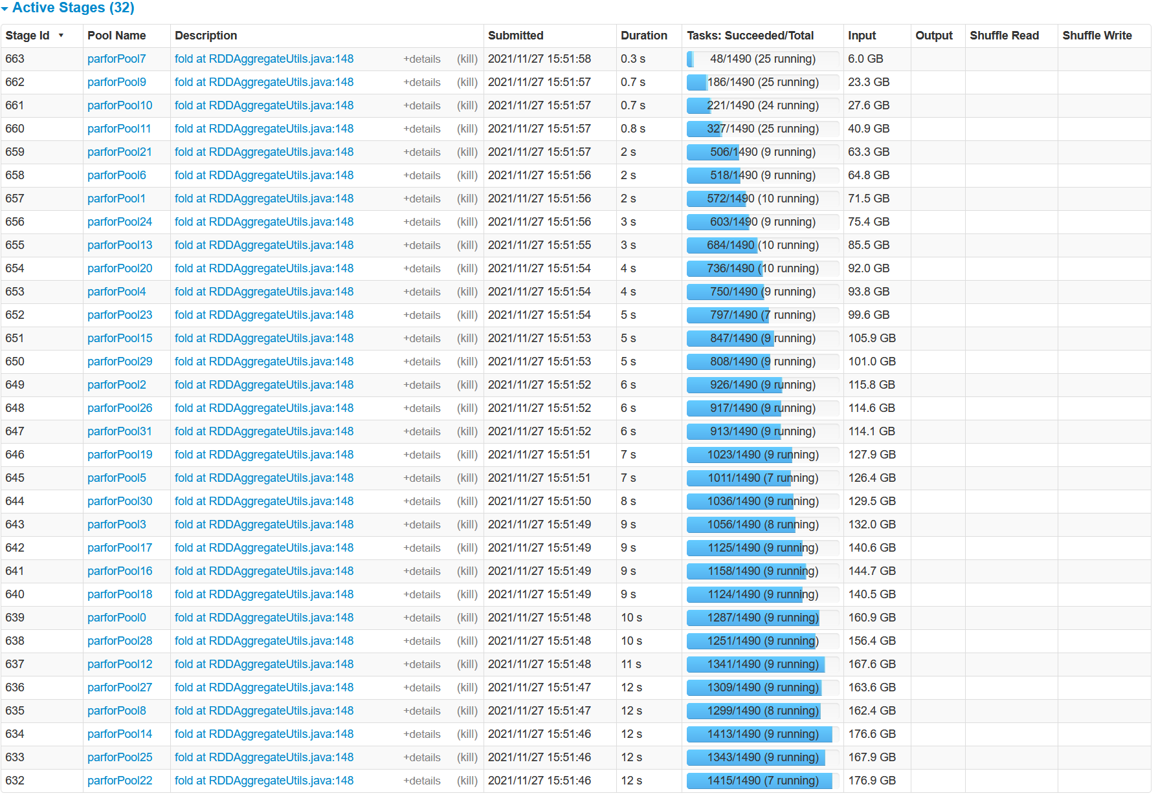
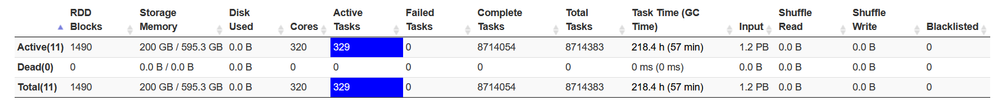
Spark Task Scheduling, cont.
Task Scheduling and Elasticity
FAIR scheduling w/ k=32 concurrent jobs and 200GB
FAIR:
Share 320 cores among 32 concurrent jobs → ~10 tasks/job
Elapsed:
~40min

Slide 29
Spark Task Scheduling, cont.
Task Scheduling and Elasticity
<allocations>
<pool name=“data_science">
<schedulingMode>FAIR</schedulingMode>
<weight>1</weight>
<minShare>6</minShare>
</pool>
<pool name=“indexing">
<schedulingMode>FIFO</schedulingMode>
<weight>2</weight>
<minShare>8</minShare>
</pool>
</allocations>
Fair Scheduler Configuration
Pools with shares of cluster
Scheduling modes: FAIR, FIFO
weight: relative to equal share
minShare: min numCores
Spark on Kubernetes
Run Spark in shared cluster with Docker container apps, Distributed TensorFlow, etc
Custom controller, and shuffle service (dynAlloc)
$SPARK_HOME/bin/spark-submit \
--master k8s://https://<k8s-api>:<k8s-api-port> \
--deploy-mode cluster
--driver-java-options "-server -Xms40g -Xmn4g" \
--driver-memory 40g \
--num-executors 10 \
--executor-memory 100g \
--executor-cores 32 \
--conf spark.kubernetes.container.image=<sparkimg> \
SystemDS.jar -f test.dml -stats -explain -args …

Slide 30
Spark Dynamic Allocation
Task Scheduling and Elasticity
[https://spark.apache.org/docs/ latest/job-scheduling.html]
Configuration for YARN/Mesos
Set spark.dynamicAllocation.enabled = true
Set spark.shuffle.service.enabled = true (robustness w/ stragglers)
Executor Addition/Removal
Approach: look at task pressure (pending tasks / idle executors)
Increase exponentially (add 1, 2, 4, 8) if pending tasks for spark.dynamicAllocation.schedulerBacklogTimeout
Decrease executors they are idle for spark.dynamicAllocation.executorIdleTimeout

Slide 31
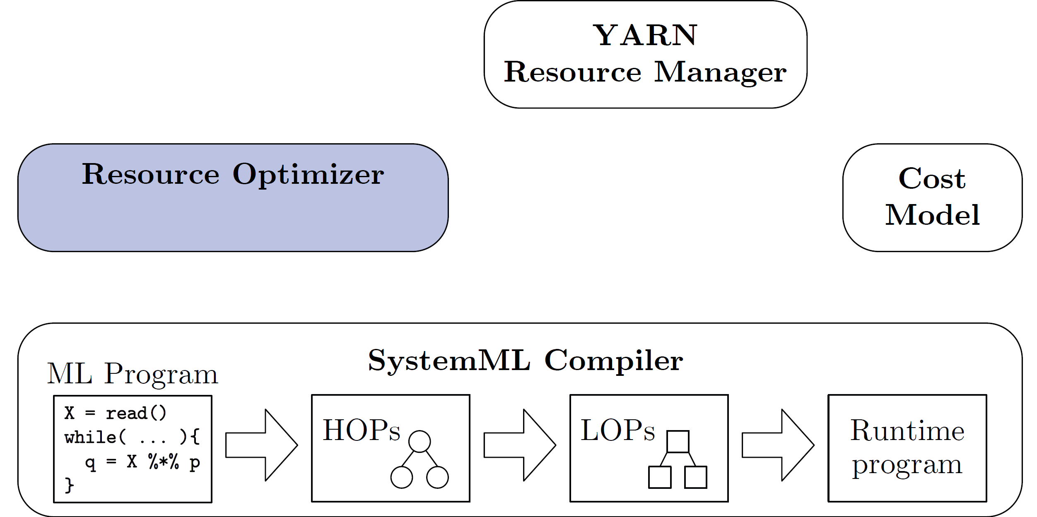
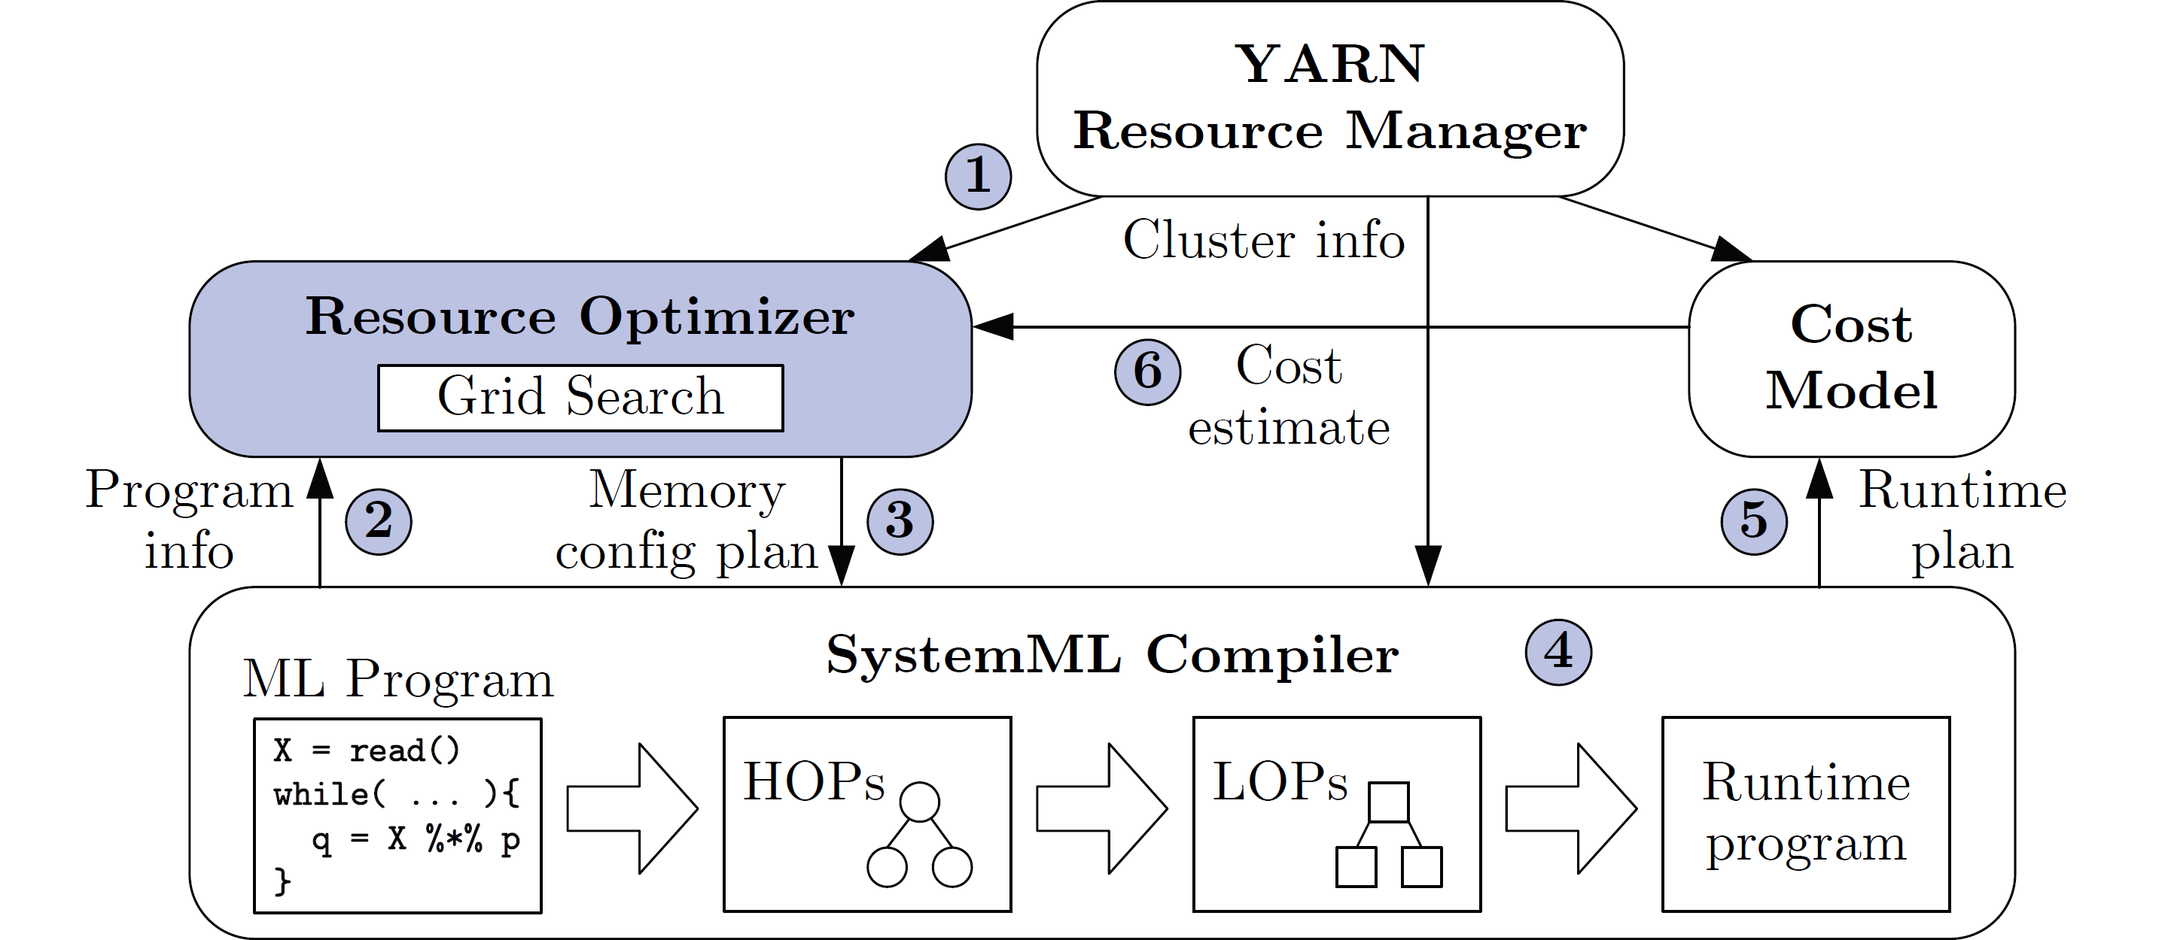
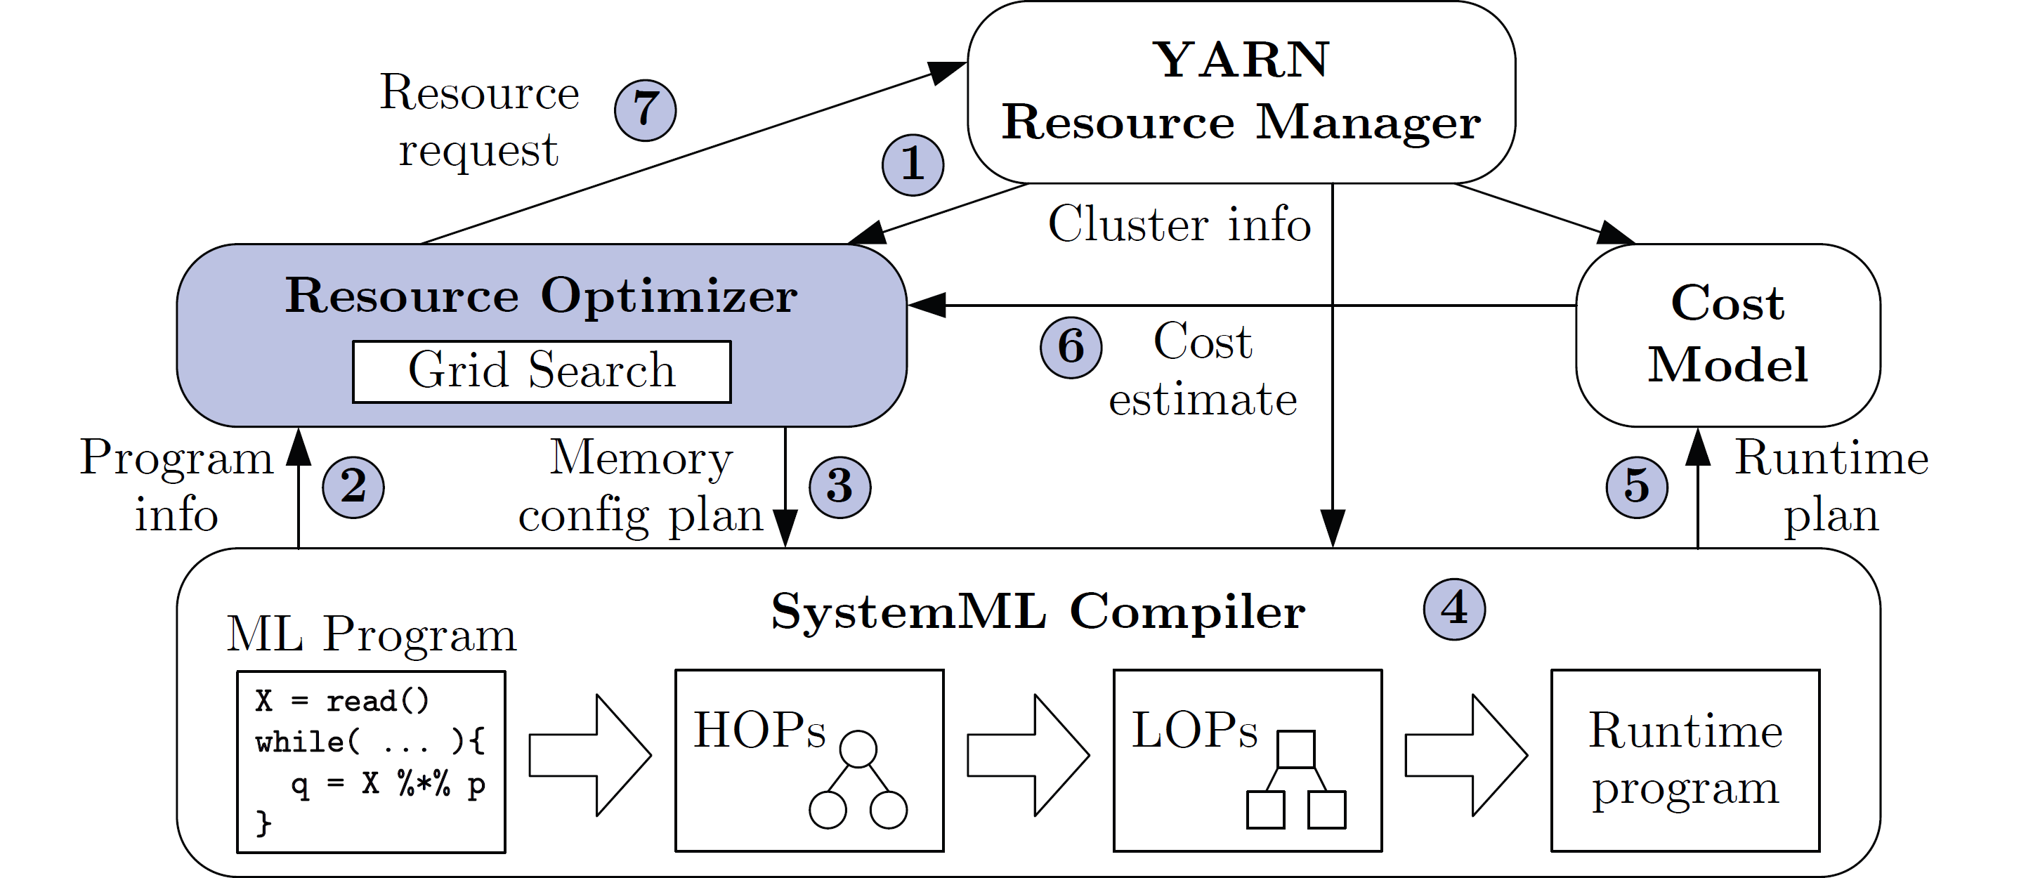
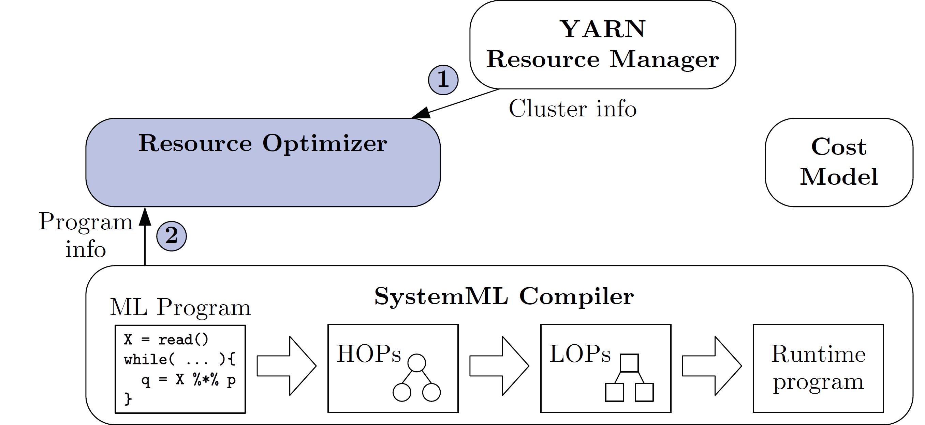
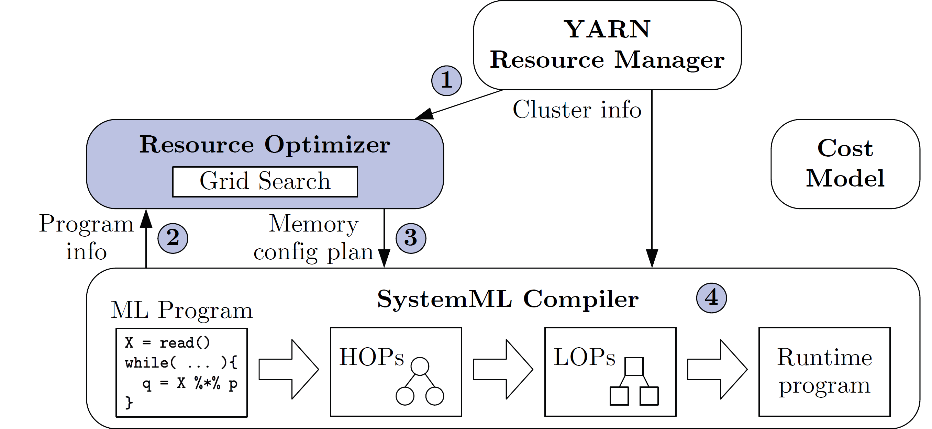
Resource Elasticity in SystemML
Task Scheduling and Elasticity
[Botong Huang et al.: Resource Elasticity for Large-Scale Machine Learning. SIGMOD 2015]
Basic Ideas
Optimize ML program resource configurations via online what-if analysis
Generating and costing runtime plans for local/MR
Program-aware grid enumeration, pruning, and re-optimization techniques
Min runtime w/o unnecessary over-allocation

Slide 32
Summary and Q&A
Motivation, Terminology, and Fundamentals
Resource Allocation, Isolation, and Monitoring
Task Scheduling and Elasticity
Next Lectures
10 Distributed Data Storage [Dec 02]

